Slide 1
Quarterly Investor Update
January 2016

Slide 2
QUARTERLY ASSET CLASS PERFORMANCE REVIEW
Cello Fixed Income Master Fund 2015: -5.63%
Q4 2015: -1.91%
Fixed Income Arbitrage Index 2015: 0.59%
Q4 2015: 0.03%
Summary: Many asset categories finished 2015 in negative territory as volatility returned to the markets. Mainstream U.S. asset classes (large-cap stocks, investment grade bonds) eked out positive returns and outpaced riskier assets. Commodities and emerging-market equities suffered significant losses amidst diminishing global growth.
Asset Class | 2015 (%) | Q4 2015 (%)
Non-U.S. Small-Cap Stocks | 9.9% | 6.8%
Real Estate Stocks | 2.8% | 7.7%
U.S. Large-Cap Stocks | 1.4% | 7.0%
Emerging-Market Bonds | 1.2% | 1.5%
Investment-Grade Bonds | 0.5% | -0.6%
Non-U.S. Developed-Country Stocks | -0.4% | 4.7%
U.S. Corporate Bonds | -0.8% | -0.5%
U.S. Mid-Cap Stocks | -2.4% | 3.6%
Long Government & Credit Bonds | -3.3% | -0.9%
U.S. Small-Cap Stocks | -4.4% | 3.6%
High-Yield Bonds | -4.6% | -2.2%
Gold | -12.1% | -4.8%
Emerging-Market Stocks | -14.6% | 0.7%
Commodities | -24.7% | -10.5%
INVERSE IO COUPON Formula: 7.0 – (Libor +50bp)
Cap: 6.50%
Floor: 0%
INVERSE IO Coupon: 7.0 – (Libor +50)
FLOATER
Coupon: L + 50bp, cap 7.0%
Source: Fidelity, Cello, and Credit Suisse Dow Jones.

Slide 3
THE YIELD CURVE FLATTENED IN THE THIRD QUARTER
The yield curve flattened in Q3 because of a meaningful decrease in long-term yields. Contributing factors to the flattening include a moderation in inflation expectations because of the plunge in commodity prices and a flight-to-quality demand because of the risk asset sell-off.
TREASURY YIELD CURVE
(March 2015 vs June 2015 vs September 2015)
Yield (%)
Quarterly Changes (bps)
1M
3M
6M
1Yr
2Yr
3Yr
5Yr
7Yr
10Yr
20Yr
30Yr
Source: Yieldbook as of 10/5/2015

Slide 4
BOND MARKET VOLATILITY REMAINED HIGH IN Q3
Fixed income volatility remained high in Q3 as the bond market digested several developments including changes in the FOMC’s plan for raising interest rates, China’s stock market decline, China’s currency devaluation, and a global slowdown in economic growth.
DISTRIBUTION OF ABSOLUTE VALUE OF 1-DAY YIELD CHANGES IN 10-YEAR TREASURIES
(Number of Days)
Year | 0-5bp | 5-10bp | 10-15bp | 15-20bp | % days > 5bp
2010 | 150 | 70 | 23 | 7 | 40%
2011 | 143 | 76 | 25 | 5 | 43%
2012 | 183 | 59 | 7 | 1 | 27%
2013 | 196 | 41 | 12 | 0 | 21%
2014 | 207 | 39 | 4 | 0 | 17%
2015 Q1 | 39 | 16 | 5 | 0 | 35%
2015 Q2 | 39 | 23 | 2 | 0 | 39%
2015 Q3 | 41 | 20 | 3 | 0 | 36%
2015 Q4 | 47 | 13 | 1 | 0 | 23%
*2015 Data as of 10/5/15
Source: Yieldbook and Cello calculations

Slide 5
QUARTERLY IOS PERFORMANCE REVIEW
When hedged for duration and curve risk, IOs performed poorly during the quarter – adding to their losses for the year. IO underperformance over the quarter was driven by a combination of spread widening and higher convexity hedging costs.
RETURNS ON IOS POSITIONS HEDGED FOR DURATION AND CURVE RISK
IOS | Q3 2015(%) | YTD (%)
FN30.300.12 | -0.8 | -14.0
FN30.350.12 | -2.8 | -10.3
FN30.400.11 | -4.0 | -4.5
FN30.450.11 | -3.2 | -3.3
FN30.350.10 | -3.3 | -9.2
FN30.400.10 | -3.2 | -5.0
Source: Cello calculations using YieldBook. The returns are generated assuming daily rebalancing of hedges.

Slide 6
PREPAYMENT BETA IN 2015
Taking on exposure to prepayment risk yielded negative returns for most IOs in 2015 (with the exception of Q4) driven by a combination of declining carry, tight spreads, and increased levels of volatility in the level and shape of the yield curve. Prepayments were faster than expected in the first half of the year and slower than expected in the second.
Cello’s defensive posture with respect to prepayment risk (as expressed by maintaining relatively low levels of IO Beta throughout the year) was validated through Q1-Q3. The portfolio did not participate in positive IOS performance in Q4 as Structured bonds widened relative to IOS.
TOTAL RETURNS ON HEDGED IOS POSITIONS
(2015)
Quarter | FN30. 300.13 | FN30. 300.12 | FN30. 350.14 | FN30. 350.13 | FN30. 350.12 | FN30. 350.10 | FN30. 400.14 | FN30. 400.13 | FN30. 400.11 | FN30. 400.10 | FN30. 400.09
2015 Q1 | -5.6% | -5.4% |  | -6.8% | -5.3% | -2.6% |  | -5.9% | -2.0% | -1.5% | 1.1%
2015 Q2 | -6.8% | -8.3% | 2.6% | 0.2% | -2.6% | -3.5% | 7.6% | 7.2% | 1.6% | -0.4% | -1.6%
2015 Q3 | -0.2% | -0.8% | 0.1% | -2.1% | -2.8% | -3.3% | -1.3% | -3.0% | -3.9% | -3.2% | -2.9%
2015 Q4 | 1.0% | 1.9% | 3.2% | 1.6% | 2.7% | 3.5% | 3.7% | 4.0% | 3.4% | 3.5% | 7.4%
Annual Return(%) | -11.2% | -12.3% | 5.9% | -7.0% | -7.8% | -6.0% | 10.1% | 1.8% | -1.1% | -1.7% | 3.6%
Source: Cello as of 12/31/2015.

Slide 7
CELLO PERFORMANCE AND DRIVERS OF RETURNS
Cello’s Q3 returns were driven by:
A low level of IO Beta
A positive exposure to long-term interest rates decreasing in order to offset IO spread risk
A modest long exposure to TBA spreads
 | Bond Carry | Bond Price P&L | Hedges | Net Return | IO Beta
Q1 2013 | 1.61% | 1.36% | -2.04% | 0.93% | 54%
Q2 2013 | 1.54% | -0.44% | -3.27% | -2.17% | 61%
Q3 2013 | 1.17% | 4.90% | -2.48% | 3.59% | 65%
Q4 2013 | 1.86% | 2.80% | -2.19% | 2.47% | 56%
Q1 2014 | 1.89% | 1.05% | 0.39% | 3.33% | 51%
Q2 2014 | 1.68% | 1.79% | -0.62% | 2.85% | 47%
Q3 2014 | 1.05% | -0.79% | 0.11% | 0.37% | 39%
Q4 2014 | 1.08% | -0.54% | 0.45% | 0.99% | 26%
Q1 2015 | 1.13% | -0.21% | -0.84% | 0.07% | 24%
Q2 2015 | 0.83% | -1.50% | -2.92% | -3.59% | 23%
Q3 2015 | 1.03% | -0.68% | -0.64% | -0.28% | 29%
* Performance results are provided for an investor in Class A1a shares of Cello Fixed Income Master Fund, LP (the “Master Fund”). Class A1a shares launched on January 1, 2012, and returns for periods prior thereto have been adjusted to reflect the management fees and performance allocations chargeable to Class A1a shares. As of January 1, 2012, all trading activities for Cello Fixed Income Fund Ltd. and Cello Fixed Income Domestic Fund, LP are being conducted through the Master Fund. Performance results are net of fees and expenses and are generally unaudited and subject to change. Certain research-related Master Fund expenses were paid for by Cello Capital Management, LLC prior to July 1, 2012. Individual returns may vary due to investment in the offshore or onshore feeder fund, the class of investment and the timing of subscriptions and redemptions.

Slide 8
IO OASs ARE AT THE TIGHT END OF THEIR RECENT RANGE
IO OASs tightened over Q4 as the amount of prepayment risk has marginally decreased and new IO buyers entered the market.
Mortgage rates remained relatively stable over the quarter. According to a widely used benchmark survey of mortgage rates, the 30-year mortgage rate increased from 3.85% on October 1st to 3.95% on December 10th.
EVOLUTION OF REFINANCEABLE UNIVERSE VERSUS IO OAS
(February 2011 to December 2015)
OAS
Refinancible Universe
Source: Barclays as of 12/14/2015

Slide 9
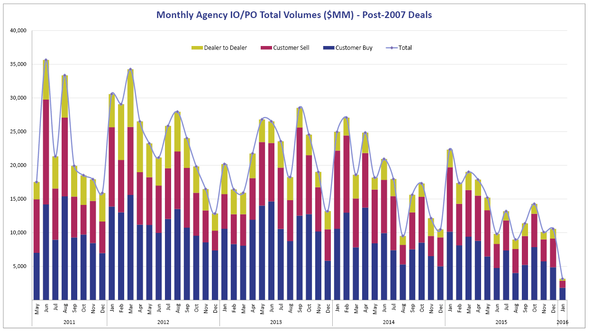
DERIVATIVE TRADING VOLUMES REMAINED MUTED IN Q4
Trading volumes remain at relatively low levels. Tight IO spreads, reduced broker-dealer balance sheets, and high levels of volatility have contributed to wide bid-offer spreads. Adding to the lack of liquidity in the market is an overall pre-occupation with the Fed’s interest rate policy. The decline in trading volumes in the IO sector is broadly consistent with declining liquidity in other fixed income sectors.
One bright spot that remains is issuance of GNMA CMOs which continues to be robust.
AGENCY DERIVATIVE TRADING VOLUMES
(May 2011 to December 2015)
Volume ($MM)
-15%
YoY
-22%
YoY
Source: TRACE as of 1/7/2015.

Slide 10
CATALYSTS FOR AN EXPANDED OPPORTUNITY SET
Within the context of the current market environment, Cello believes that there are five catalysts that could lead to an expanded opportunity set.
Catalyst | Comments
Sharp Drop in Mortgage rates | OASs would widen sharply in this scenario and generate opportunities for investors such as Cello who have prudently maintained lower IO exposure.
Fed Policy Surprises | This would lead to a significant increase in interest rate volatility, which IO and Inverse IO spreads are currently not pricing in.
Increases in Credit Risk premiums | Although the risk embedded in Agency MBS is mainly prepayment risk, and therefore the associated cash flows are uncorrelated to credit, often spread widening in credit markets can affect Agency MBS pricing leading to increased opportunities.
Regulatory Impacts on Bank Portfolio Liquidity | The imposition of LCR has led to sustained demand for GNMA MBS in order to fulfill HQLA requirements. A decrease in the Fed’s balance sheet will drive banks to purchase more Treasuries and GNMAs to meet Level 1 HQLA requirements.
Regulatory changes in mortgage lending terms | Further attempts to stimulate the housing market through expansion of the credit box, rep/warranty relief, reductions in MIPs or g-fees could create market distortions.

Slide 11
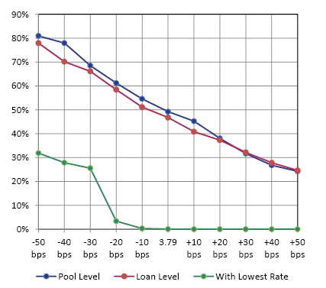
IT WILL TAKE A SIGNIFICANT DECREASE IN RATES TO TRIGGER A PREPAYMENT SURGE
The refinanceable fraction of the mortgage universe is an important indicator of prepayment risk. Cello has developed several different ways of estimating this indicator.
Cello’s estimates suggest that mortgage rates probably need to fall by about 20-25bps to trigger a meaningful increase in prepayment rates, and by about 30-40bps to trigger a surge.
THE REFINANCEABLE UNIVERSE AS A FUNCTION OF MORTGAGE RATES
(8th January 2016)
Source: Cello

Slide 12
BOND/SECTOR SELECTION
Bond/sector selection in the IO sector depends heavily on prepayment model assumptions.
Cello leverages its Symphony application to compare historical prepayment data versus prepayment model forecasts across different interest rate scenarios.
For example, Cello’s analysis shows that front sequentials backed by High LTV U6 2013 4s collateral offer OASs in excess of 400bps.
LEVERAGING SYMPHONY AND CELLO PREPAY PROJECTIONS
Source: Cello

Slide 13
STRATEGY OUTLOOK
Risk Factors | Positioning | Rationale
IO Beta (Prepayment Risk) | IO exposure of 30-40% | IO spreads are on the tight side but prepayment fatigue has likely set in after several years of low rates
MBS Basis | Modest long | Spreads look fair and carry on TBAs look attractive.
Interest Rates | Overweight | IO spreads are correlated with interest rates as drop in interest rates typically lead to IO spread widening.
Sector Allocation | Overweight CQs, CRs, GN and Conventional Jumbo | Market is over-penalizing certain High LTV loans. GNMA CMOs are being issued at attractive levels.

Slide 14
DISCLOSURES Important Notes
THIS DOCUMENT IS NOT AN OFFER TO SELL OR THE SOLICITATION OF AN OFFER TO BUY SHARES OF THE FUND. AN OFFERING OF INTERESTS WILL BE MADE ONLY BY MEANS OF A CONFIDENTIAL PRIVATE PLACEMENT MEMORANDUM AND ONLY TO QUALIFIED INVESTORS IN JURISDICTIONS WHERE PERMITTED BY LAW. PAST PERFORMANCE IS NO GUARANTEE OF FUTURE PERFORMANCE.
An investment in the Fund is speculative and involves a high degree of risk. The Fund will have substantial limitations on investors’ ability to redeem or transfer their shares, and no secondary market for the Fund’s shares exists or will develop. All of these risks, and other important risks, are described in detail in the Fund’s Confidential Private Placement Memorandum. Prospective investors are strongly urged to review this Confidential Private Placement Memorandum carefully and consult with their own financial, legal and tax advisors, before investing.
Portions of this document may contain commentary and/or data based on certain current assumptions by Cello Capital Management, LP (“Cello”), which are subject to change at any time, as well as Cello's internal complex calculations. If one or more of these assumptions or calculations is incorrect, the information contained herein may unintentionally be inaccurate.
Certain information contained herein may have been obtained by Cello from third parties. While Cello believes such sources are reliable, Cello has not verified the accuracy of such information and shall not be liable for any errors in such information or for any actions taken in reliance thereon.
This document may also contain certain forward looking statements and projections. Such statements and projections are subject to a number of assumptions, risks and uncertainties which may cause actual results, performance or achievements to be materially different from future results, performance or achievements expressed or implied by these forward-looking statements and projections. Prospective investors are cautioned not to invest based on these forward-looking statements and projections.
This document may contain references to certain internal Cello procedures and policies which are subject to change at any time.
No information or material contained herein may be reproduced, transmitted, displayed or commercially exploited without the prior written consent of Cello. All rights are reserved.

